Slide 1

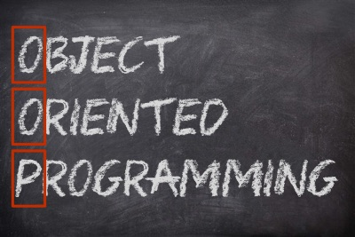

Наследяване
Йерархии от класове
ООП
Учителски екип
Обучение за ИТ кариера
https://it-kariera.mon.bg/e-learning/

Slide 2

Съдържание
Наследяване
Йерархии от класове
Наследяване в C#
Достъп до членове на базовия клас

Slide 3
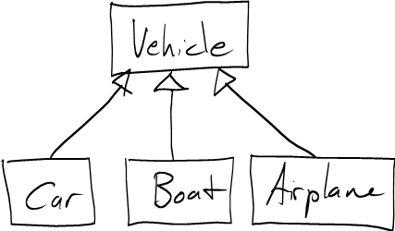
Наследяване
Разширяване на класове
3

Slide 4
Наследяване
Суперклас – родителски клас, базов клас
Класът, който дава своите членове на дъщерния си клас
Подклас – Дъщерен клас, производен клас
Класът, който получава членове от своя базов клас
Суперклас
Базов
Дъщерен
Подклас

Slide 5
Наследяване – пример
Базов клас
Person
+Name: string
+Address: string
Производен клас
Производен клас
Employee
Student
+Company: string
+School: string

Slide 6
Йерархия от класове
Наследяването води до йерархии от класове и/или интерфейси в приложението:
Базовите класове съдържат общи характеристики
Game
SinglePlayerGame
MultiplePlayersGame
Minesweeper
Solitaire
BoardGame
…
…
Chess
Backgammon

Slide 7
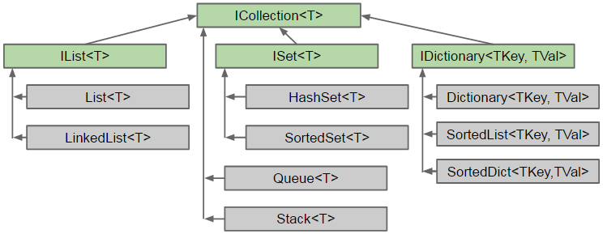
Йерархия от класове – C# Collection

Slide 8
Наследяване в C#
В C# наследяването се отбелязва чрез : оператора
class Person { … }
class Student : Person { … }
class Employee : Person { … }
Person
Student : Person
Student
Employee
Notes:
Extensibility / Polymorphism: New functionality may be easily plugged in without changing existing classes as long the new plug-in classes extend given base classes.
Reusability: For a set of similar applications a framework can be defined using a core set of classes that are to be extended by classes that fill in the application-dependent part.
Information Hiding: If a more general class using a simpler contract is sufficient, details from extending classes may be hidden to some of the client classes. This allows them to be more independent from possible changes and diminishes the load of contracts that must be understood by a reader of these client classes.
(c) 2006 National Academy for Software Development - http://academy.devbg.org*
8##

Slide 9
Наследяване – дъщерен клас
Класът получава всички членове от родителския си клас
Person
Преизползване на Person
Mother : Person
Father : Person
Student
Employee
School: School
Org: Organization

Slide 10
Използване на наследени членове
Наследените членове се използват както обикновено:
class Person { public void Sleep() { … } }
class Student : Person { … }
class Employee : Person { … }
Student student = new Student();
student.Sleep();
Employee employee = new Employee();
employee.Sleep();
Notes:
Extensibility / Polymorphism: New functionality may be easily plugged in without changing existing classes as long the new plug-in classes extend given base classes.
Reusability: For a set of similar applications a framework can be defined using a core set of classes that are to be extended by classes that fill in the application-dependent part.
Information Hiding: If a more general class using a simpler contract is sufficient, details from extending classes may be hidden to some of the client classes. This allows them to be more independent from possible changes and diminishes the load of contracts that must be understood by a reader of these client classes.
(c) 2006 National Academy for Software Development - http://academy.devbg.org*
10##

Slide 11
Преизползване на конструктори
Конструкторите не се наследяват
Конструкторите може да се ползват от дъщерните класове
class Student : Person {
private School school;
public Student(String name, School school)
:base(name)
{
this.school = school;
}
}
Notes:
Extensibility / Polymorphism: New functionality may be easily plugged in without changing existing classes as long the new plug-in classes extend given base classes.
Reusability: For a set of similar applications a framework can be defined using a core set of classes that are to be extended by classes that fill in the application-dependent part.
Information Hiding: If a more general class using a simpler contract is sufficient, details from extending classes may be hidden to some of the client classes. This allows them to be more independent from possible changes and diminishes the load of contracts that must be understood by a reader of these client classes.
(c) 2006 National Academy for Software Development - http://academy.devbg.org*
11##

Slide 12
Наследяването е разширяване
Инстанцията на дъщерен клас съдръжа инстанция на неговия базов клас
Student (Derived Class)
+Study():void
Employee (Derived Class)
+Work():void
Person (Base Class)
+Sleep():void

Slide 13
Наследяване
Наследяването има преходна връзка
class Person { … }
class Student : Person { … }
class CollegeStudent : Student { … }
Person
Student
CollegeStudent
Notes:
Extensibility / Polymorphism: New functionality may be easily plugged in without changing existing classes as long the new plug-in classes extend given base classes.
Reusability: For a set of similar applications a framework can be defined using a core set of classes that are to be extended by classes that fill in the application-dependent part.
Information Hiding: If a more general class using a simpler contract is sufficient, details from extending classes may be hidden to some of the client classes. This allows them to be more independent from possible changes and diminishes the load of contracts that must be understood by a reader of these client classes.
(c) 2006 National Academy for Software Development - http://academy.devbg.org*
13##

Slide 14
Множествено наследяване
В C# не се поддържа множествено наследяване
Поддържа се само имплементиране на множество интерфейси
Person
Student
CollegeStudent
Notes:
Extensibility / Polymorphism: New functionality may be easily plugged in without changing existing classes as long the new plug-in classes extend given base classes.
Reusability: For a set of similar applications a framework can be defined using a core set of classes that are to be extended by classes that fill in the application-dependent part.
Information Hiding: If a more general class using a simpler contract is sufficient, details from extending classes may be hidden to some of the client classes. This allows them to be more independent from possible changes and diminishes the load of contracts that must be understood by a reader of these client classes.
(c) 2006 National Academy for Software Development - http://academy.devbg.org*
14##

Slide 15
Достъп до членове на базовия клас
Чрез ключовата дума basе
class Person { … }
class Employee : Person
{
void Fire(string reasons) {
Console.Writeline
($"{base.name} got fired because {reasons}");
}
}
Notes:
Extensibility / Polymorphism: New functionality may be easily plugged in without changing existing classes as long the new plug-in classes extend given base classes.
Reusability: For a set of similar applications a framework can be defined using a core set of classes that are to be extended by classes that fill in the application-dependent part.
Information Hiding: If a more general class using a simpler contract is sufficient, details from extending classes may be hidden to some of the client classes. This allows them to be more independent from possible changes and diminishes the load of contracts that must be understood by a reader of these client classes.
(c) 2006 National Academy for Software Development - http://academy.devbg.org*
15##

Slide 16

Задача: Наследяване
Animal
+Eat():void
Dog
+Bark():void
Notes:
Extensibility / Polymorphism: New functionality may be easily plugged in without changing existing classes as long the new plug-in classes extend given base classes.
Reusability: For a set of similar applications a framework can be defined using a core set of classes that are to be extended by classes that fill in the application-dependent part.
Information Hiding: If a more general class using a simpler contract is sufficient, details from extending classes may be hidden to some of the client classes. This allows them to be more independent from possible changes and diminishes the load of contracts that must be understood by a reader of these client classes.
(c) 2006 National Academy for Software Development - http://academy.devbg.org*
16##

Slide 17
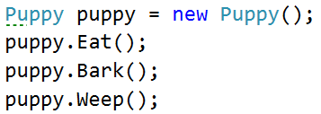
Задача: Наследяване на няколко нива
Animal
+Eat():void
Dog
+Bark():void
Puppy
+Weep():void
Notes:
Extensibility / Polymorphism: New functionality may be easily plugged in without changing existing classes as long the new plug-in classes extend given base classes.
Reusability: For a set of similar applications a framework can be defined using a core set of classes that are to be extended by classes that fill in the application-dependent part.
Information Hiding: If a more general class using a simpler contract is sufficient, details from extending classes may be hidden to some of the client classes. This allows them to be more independent from possible changes and diminishes the load of contracts that must be understood by a reader of these client classes.
(c) 2006 National Academy for Software Development - http://academy.devbg.org*
17##

Slide 18
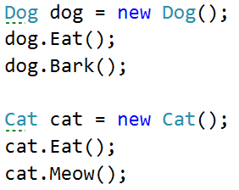
Задача: Йерархично наследяване
Animal
+Eat():void
Dog
Cat
-Bark():void
-Meow():void
Notes:
Extensibility / Polymorphism: New functionality may be easily plugged in without changing existing classes as long the new plug-in classes extend given base classes.
Reusability: For a set of similar applications a framework can be defined using a core set of classes that are to be extended by classes that fill in the application-dependent part.
Information Hiding: If a more general class using a simpler contract is sufficient, details from extending classes may be hidden to some of the client classes. This allows them to be more independent from possible changes and diminishes the load of contracts that must be understood by a reader of these client classes.
(c) 2006 National Academy for Software Development - http://academy.devbg.org*
18##

Slide 19

Наследяване
Лаб
19

Slide 20

Какво научихме днес?
Наследяването е силен инструмент за преизползване на код
Подкласа наследява членове от суперкласа

Slide 21
Наследяване
https://it-kariera.mon.bg/e-learning/

Slide 22

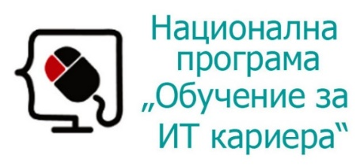


Министерство на образованието и науката (МОН)
Настоящият курс (презентации, примери, задачи, упражнения и др.) е разработен за нуждите на Национална програма "Обучение за ИТ кариера" на МОН за подготовка по професия "Приложен програмист"
Курсът е базиран на учебно съдържание и методика, предоставени от фондация "Софтуерен университет" и се разпространява под свободен лиценз CC-BY-NC-SA

